Slide 1

Customer Shopping Behavior Analysis
Analyzing 3,900 purchases to uncover insights into spending patterns, customer segments, product preferences, and subscription behavior.

Slide 2

Project Overview & Dataset
Project Goal
Dataset Size
Guide strategic business decisions through data-driven insights.
3,900 rows, 18 columns of transactional data.
Key Features
Demographics, purchase details, shopping behavior.

Slide 3

Dataset Summary: Key Features
Customer Demographics
Purchase Details
Shopping Behavior
Age, Gender, Location, Subscription Status.
Item, Category, Amount, Season, Size, Color.
Discount, Promo, Previous Purchases, Frequency, Review, Shipping.

Slide 4
Exploratory Data Analysis (Python)
01
02
Data Loading & Exploration
Missing Data Handling
Pandas import, structure check, summary statistics.
Imputed Review Rating with median per category.
03
04
Column Standardization
Feature Engineering
Renamed columns to snake_case for readability.
Created age_group and purchase_frequency_days.
05
06
Data Consistency
Database Integration
Dropped redundant promo_code_used column.
Loaded cleaned data into PostgreSQL for SQL analysis.

Slide 5
Data Analysis (SQL): Key Insights
1
2
Revenue by Gender
High-Spending Discount Users
Male: $157,890, Female: $75,191.
839 customers spent above average with discounts.
3
4
Top 5 Products by Rating
Shipping Type Comparison
Gloves (3.86), Sandals (3.84), Boots (3.82), Hat (3.80), Skirt (3.78).
Express avg. $60.48, Standard avg. $58.46.

Slide 6
SQL Insights: Subscriptions & Discounts
Subscribers vs. Non-Subscribers
Discount-Dependent Products
Top 5 products with highest percentage of discounted purchases:
Yes
1053
$59.49
$62,645
No
2847
$59.87
$170,436
Hat (50%)
Sneakers (49.66%)
Coat (49.07%)
Sweater (48.17%)
Pants (47.37%)

Slide 7

SQL Insights: Customer Segmentation
Loyal
3116 Customers
New
83 Customers
Returning
701 Customers
Segments based on purchase history.

Slide 8
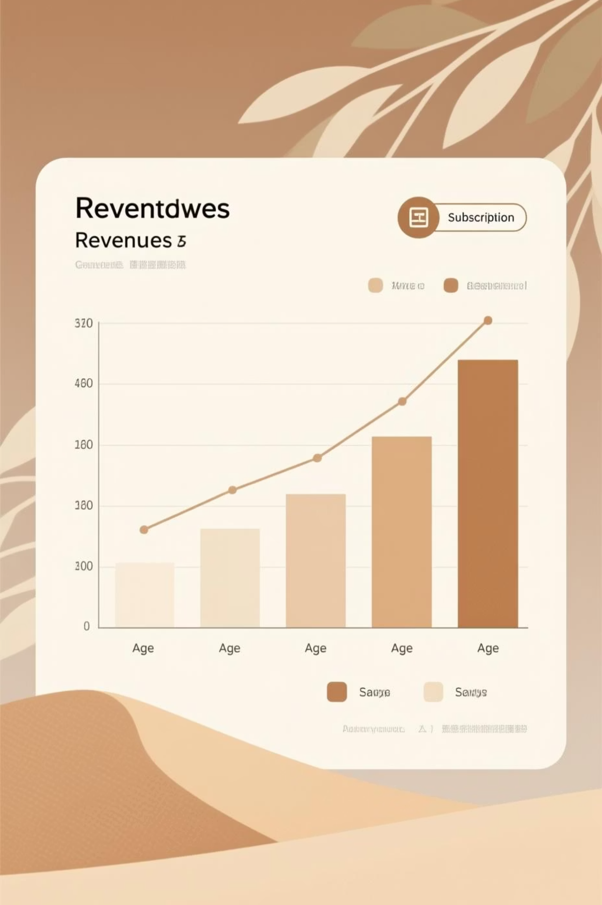
SQL Insights: Product & Age Revenue
Repeat Buyers & Subscriptions
Revenue by Age Group
Young Adult: $62,143
Customers with >5 purchases:
Middle-aged: $59,197
No Subscription: 2518
Adult: $55,978
Yes Subscription: 958
Senior: $55,763
Repeat buyers are more likely to subscribe.

Slide 9
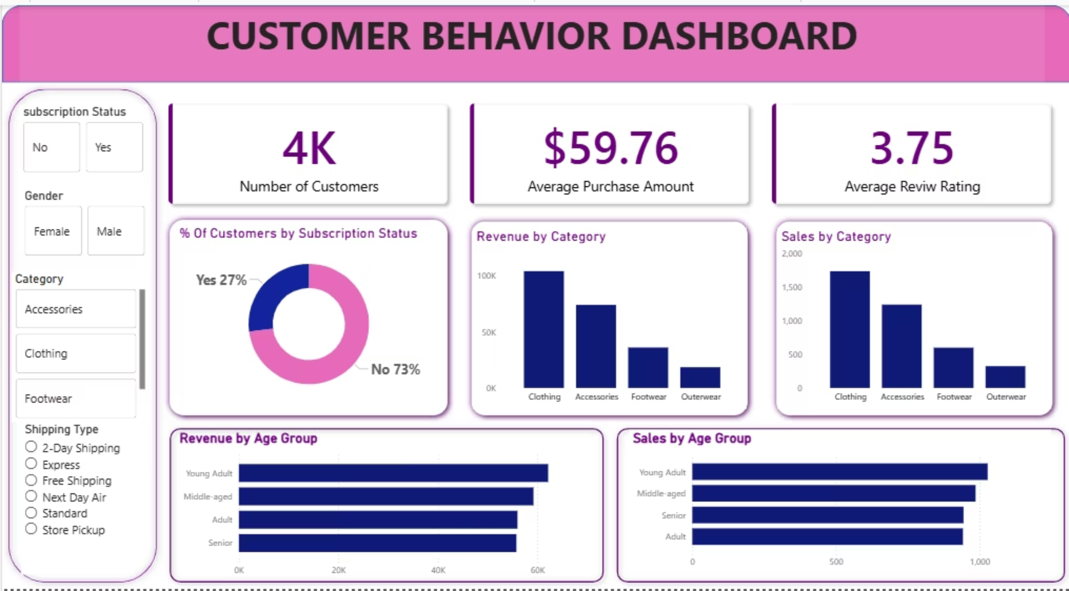
Interactive Dashboard in Power BI
Visualizing insights for strategic decision-making.

Slide 10
Business Recommendations
Boost Subscriptions
Promote exclusive benefits to increase subscriber base.
Customer Loyalty Programs
Reward repeat buyers to foster "Loyal" segment growth.
Review Discount Policy
Balance sales boosts with profit margin control.
Product Positioning
Highlight top-rated and best-selling products in campaigns.
Targeted Marketing
Focus efforts on high-revenue age groups and express-shipping users.

Slide 11

Thank you!

